Slide 1
Spatio – Temporal Outlier Detection in Environmental Data
Dr. Tao Cheng¹ Berk Anbaroğlu^{1,2}
¹ Civil, Environmental & Geomatic Engineering Dept.
University College London
{tao.cheng, b.anbaroglu}@ucl.ac.uk
² Geodesy and Photogrammetry Engineering Dept.
Hacettepe University
banbar@hacettepe.edu.tr

Slide 2
Outline
Introduction – definition of STO
Existing methods on STO detection
Our Approach
The case study
Conclusion – Future Work

Slide 3
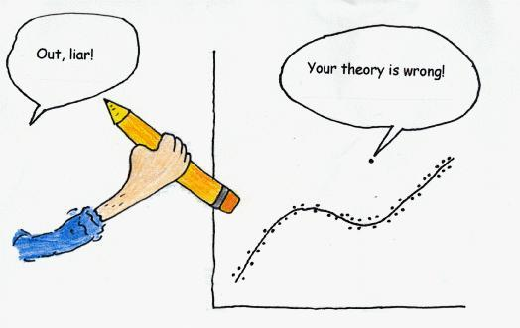
1. Introduction
http://www.bio.uu.nl/~biostat/outlier.gif

Slide 4
1. Introduction..
Spatio-temporal outlier (STO) is an object whose
non-spatial attribute value is significantly different
from those of other objects in its
spatio-temporal neighbourhood (STN).
x | x | x
x | x | x
x | x | x
 | t-1
x | x | x
x | o | x
x | x | x
 | t
x | x | x
x | x | x
x | x | x
 | t+1
x | x | x
o | o | x
x | x | x
 | t-1
x | x | x
x | o | x
x | x | x
 | t
x | x | o
x | o | x
x | x | x
 | t+1

Slide 5
1. Introduction..
May occur either because of;
Rare occurring spatial events (e.g. big earthquakes, volcanic activities, hurricanes, floods) or
Faulty observations due to sensor failure.
Important to capture and handle STOs
Better modelling and understanding of the spatial phenomena.
Detecting the faulty sensor

Slide 6
1. Introduction..
(STO) is an object whose non-spatial attribute value is significantly different from those of other objects in its spatio-temporal neighbourhood (STN).
Two definition need to be quantified
Significantly different?
STN of an instance?

Slide 7
2. Outlier detection methods
1. Distance based [1,3]
➔ If the distance from a point to another points is high than the predefined value, that point is outlier.
2. Signal processing - wavelet analysis [2,4]
➔ Higher frequency component of a signal is outlier.
3. Clustering [5,6,12]
➔ Outliers are by-products of clustering: The ones that can not be put in a cluster.
4. Visualization [8]
➔ Combination of visual methods with statistics.
5. Graph-based [7,9]
➔ Outlier detection in network data. Relies on graph theory.

Slide 8
2. Limits in existing methods
Most of the research did not consider space – time in an integrated manner.
No quantitative means to define STN.
Need to define several parameters, especially in clustering method. (e.g. number of outliers, k in k-NN, thresholds)
Intuitive definition of STN.

Slide 9
3. Our Approach
2 step procedure:
1. Using an existing space-time series analysis method - STARIMA ^{[13]} ,to define STN of an instance
2. After defining STN of an instance, finding STOs in the data.

Slide 10
3. Our Approach..
Step 1: Defining STN using STARIMA ^{[10,11,13]}
where p is the autoregressive order,
q is the moving average order,
m_{k} is the spatial order of the k^{th} autoregressive term,
n_{l} is the spatial order of the l^{th} moving average term,
Φ_{kh} is the autoregressive parameter at temporal lag k and spatial lag h,
θ_{lh} is the moving average parameter at temporal lag l and spatial lag h,
W^{(h)} is the N N matrix of weights for spatial order h, and
ε_{i}(t) is a normally distributed random error at time t and location i.

Slide 11
3. Our Approach..
Space-time dependence is measured by space-time autocorrelation function (ST-ACF) and space-time partial autocorrelation function (ST-PACF).
Different ST-ACF or ST-PACF could exist ^{[13]}.

Slide 12
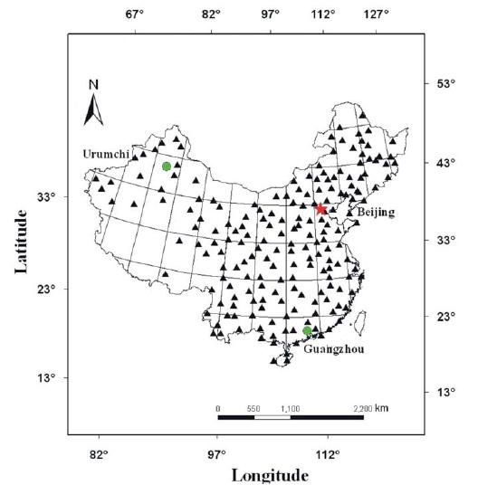
4. Case study
Data used is the annual temperature data of China observed from 137 stations between 1951 to 2002.
LOG | LAT | ALT | 1951 | 1952 | 1953
126,39 | 51,43 | 177,40 | -2 | -1,8 | -1,7
121,41 | 50,29 | 732,60 | -5,6 | -5,8 | -5,7
119,45 | 49,13 | 610,20 | -2,5 | -3,8 | -2,9
125,14 | 49,10 | 242,20 | -1 | -2,5 | -1,6
127,21 | 49,26 | 234,50 | -2 | -2,3 | -2
121,55 | 48,46 | 739,70 | -2,4 | -2,3 | -1,1
125,53 | 48,03 | 234,60 | 0,6 | -0,8 | 0
119,57 | 47,10 | 1027,40 | -4 | -3,9 | -4,2
123,55 | 47,23 | 145,90 | 2,2 | 1,6 | 2,5
Spatial neighbourhood: All sensors within 1550km distance to each other ^{[11]}.
Temporal neighbourhood: Two previous years.
[11]

Slide 13
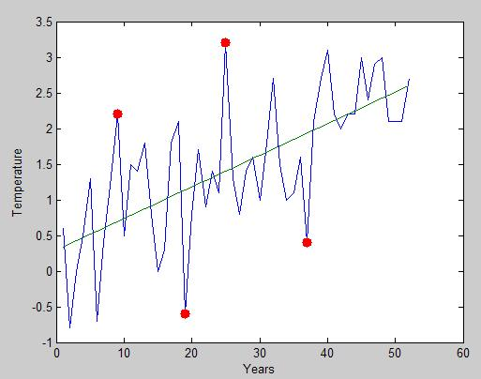
4. Case study
Step 2: Finding STOs in the data
Time Series Analysis
→ Linear regression
→ Possible outlier detection

Slide 14
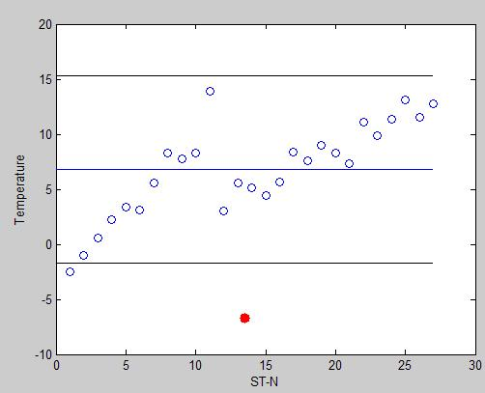
4. Case study..
Step 2: Finding STOs in the data
Validation of possible outliers
→ ST-N construction of possible outliers based on geo-statistics
→ STO detection:
z_{i}(t) ≥ µ_{STNi(t)} + k.σ_{STNi(t)}
ν z_{i}(t) = STO
z_{i}(t) ≤ µ_{STNi(t)} – k.σ_{STNi(t)}

Slide 15
5. Conclusion – Future Work
Spatio-temporal data mining is an emerging topic and STO detection takes important attention.
Existing researches are lack to provide a quantitative measure to define STN of an instance.
This research proposes to use STARIMA modelling to define STN of an instance. Experiments were conducted on temperature data of China.
We aimed to quantize STN. What about the 2nd question in STO detection; significantly different?
Density problems in the data.
Defining STN quantitatively in network data.

Slide 16
References
Adam, N.R., Janeja, V.P., Atluri, V.: Neighborhood based Detection of Anomalies in High Dimensional Spatio-Temporal Sensor Datasets. In: ACM Symposium on Applied Computing, pp. 576—583. ACM (2004)
Barua, S., Alhajj, R.: Parallel Wavelet Transform for Spatio-Temporal Outlier Detection in Large Meteorological Data. In: Intelligent Data Engineering and Automated Learning – IDEAL 2007, vol. 4881, pp. 684—694. Springer, Heidelberg (2007)
Yuxiang, S., Kunqing, X., Xiujun M., Xingxing. J., Wen. P., Xiaoping G.: Detecting Spatio-Temporal Outliers in Climate Dataset: A Method Study. In: Geoscience and Remote Sensing Symposium, vol.2, pp.760—763. IEEE (2005)
Lu, C.Y., Liang, L.R.: Wavelet Fuzzy Classification for Detecting and Tracking Region Outliers in Meteorological Data. In: Proceedings of the 12th annual ACM international workshop on Geographic information systems, pp. 258—265, ACM (2004)
Birant, D., Kut, A.: Spatio-Temporal Outlier Detection in Large Databases. In: 28th International Conference Information Technology Interfaces, pp. 179—184. IEEE (2006)
Cheng, T., Li, Z.:A Multiscale Approach to Detect Spatial-Temporal Outliers. In: Transactions in GIS, vol. 10, pp. 253—263, Blackwell Publishing (2006)
Li, X., Li, Z., Han, J., Lee, J.G.: Temporal Outlier Detection in Vehicle Traffic Data. In: Proceeding of International Conference on Data Engineering (2009)
Jin, Y., Dai, J., Lu, C.T.: Spatial-Temporal Data Mining in Traffic Incident Detection. In: SIAM Conference in Data Mining (2006)

Slide 17
References
Kou, Y., Lu, C.T., Santos Jr., R.F.D.: Spatial Outlier Detection: A Graph-based Approach. In: 19th IEEE International Conference on Tools with Artificial Intelligence, pp. 281—288. IEEE (2007)
Pfeifer, P.E., Deutsch, S.J.: A Three-Stage Iterative Procedure for Space-Time Modeling. In: Technometrics, vol 22, pp. 35—47. ASA (1980)
Cheng, T., Wang, J.Q., Li, X., Zhang, W.: A Hybrid Approach to Model Nonstationary Space-Time Series. In: The International Archives of the Photogrammetry, Remote Sensing and Spatial Information Sciences, vol. XXXVII, pp. 195—202, ISPRS (2008)
Martin, R. L., Oeppen, J. E.: The Identification of Regional Forecasting Models Using Space-Time Correlation Functions. In: Transactions of the Institute of British Geographers, vol 66, pp. 95- 118, (1975)
Box, G. E.P., Jenkins, G.M., Reinsel G.C.: Time Series Analysis: Forecasting and Control. Prentice-Hall (1994)

Slide 18
Thank you!

